Slide 1
BIEN 401 Biomedical Mass Transport Class 16 Using Simulink
notes prepared by
Dr. Louis Reis
Created on 4/16/2022

Slide 2
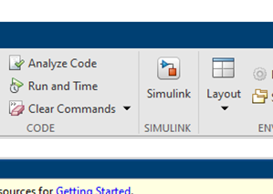
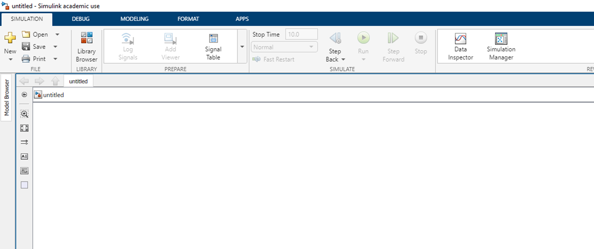
Getting Started
Simulink is a useful tool embedded in MATLAB that uses block elements to complete certain actions or operations as oppose to the coding language used in MATLAB.
To get started: press the Simulink button at the top.
Open a Blank Model.

Slide 3
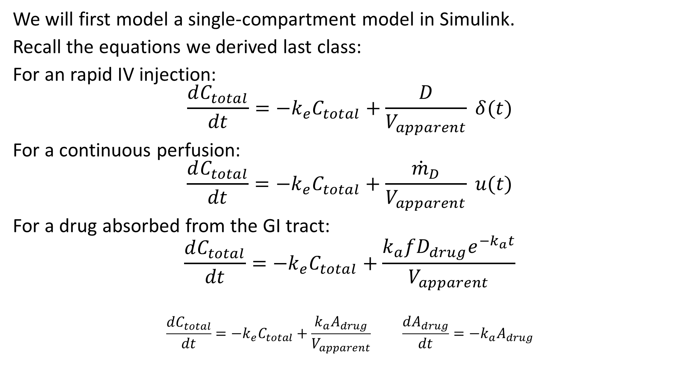
Modeling a Single-Compartment Model
We will first model a single-compartment model in Simulink.
Recall the equations we derived last class:
For an rapid IV injection:
$$\frac{dC_{total}}{dt}=−k_{e}C_{total}+\frac{D}{V_{apparent}} δ(t)$$
For a continuous perfusion:
$$\frac{dC_{total}}{dt}=−k_{e}C_{total}+\frac{{\dot{m}}_{D}}{V_{apparent}} u(t)$$
For a drug absorbed from the GI tract:
$$\frac{dC_{total}}{dt}=−k_{e}C_{total}+\frac{k_{a}fD_{drug}e^{−k_{a}t}}{V_{apparent}}$$
$$\frac{dC_{total}}{dt}=−k_{e}C_{total}+\frac{k_{a}A_{drug}}{V_{apparent}} \frac{dA_{drug}}{dt}=−k_{a}A_{drug}$$

Slide 4
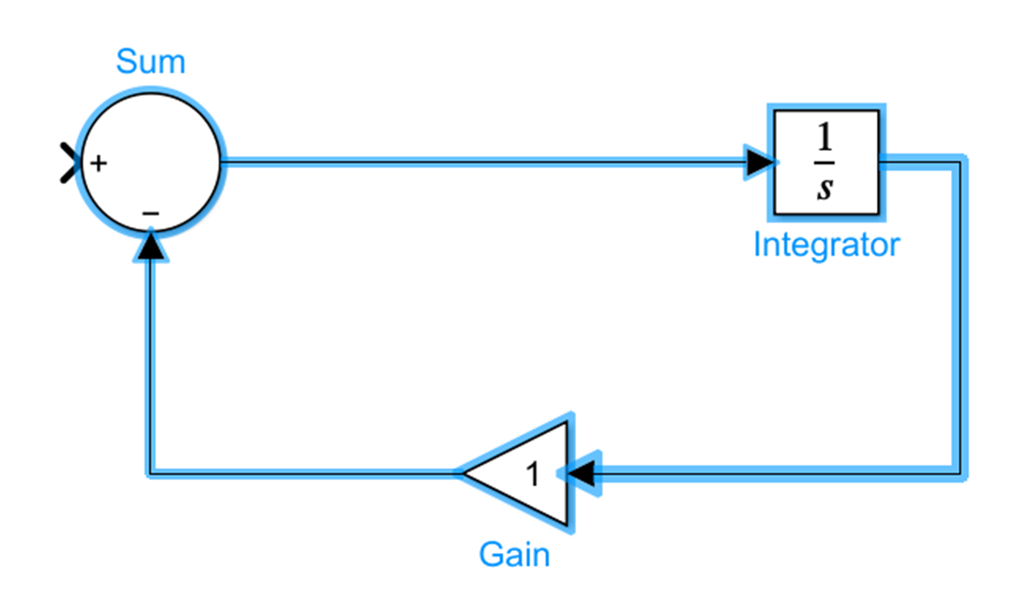
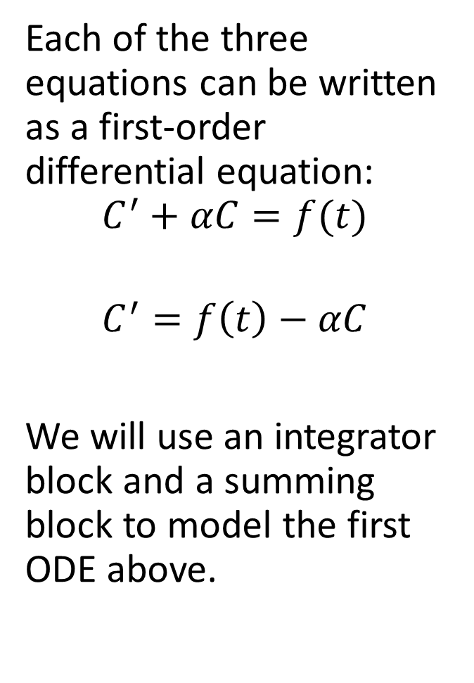
Modeling a Single-Compartment Model
Each of the three equations can be written as a first-order differential equation:
$$C^{′}+αC=f(t)$$
$$C^{′}=f\left(t\right)−αC$$
We will use an integrator block and a summing block to model the first ODE above.
Many of the block elements can be found under “Commonly Used Blocks” or “Math Operations”.
You can change the signs in the summing node by double-clicking on the block.

Slide 5
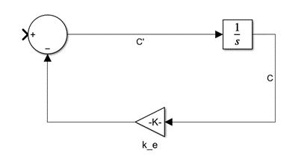
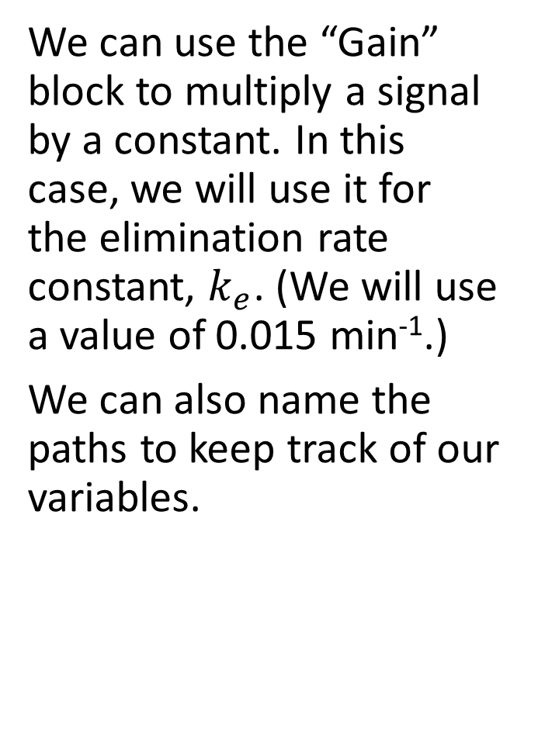
Modeling a Single-Compartment Model
We can use the “Gain” block to multiply a signal by a constant. In this case, we will use it for the elimination rate constant, $k_{e}$. (We will use a value of 0.015 min⁻¹.)
We can also name the paths to keep track of our variables.

Slide 6
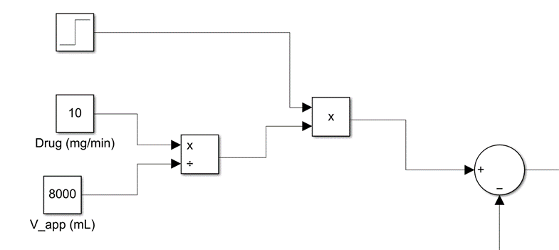
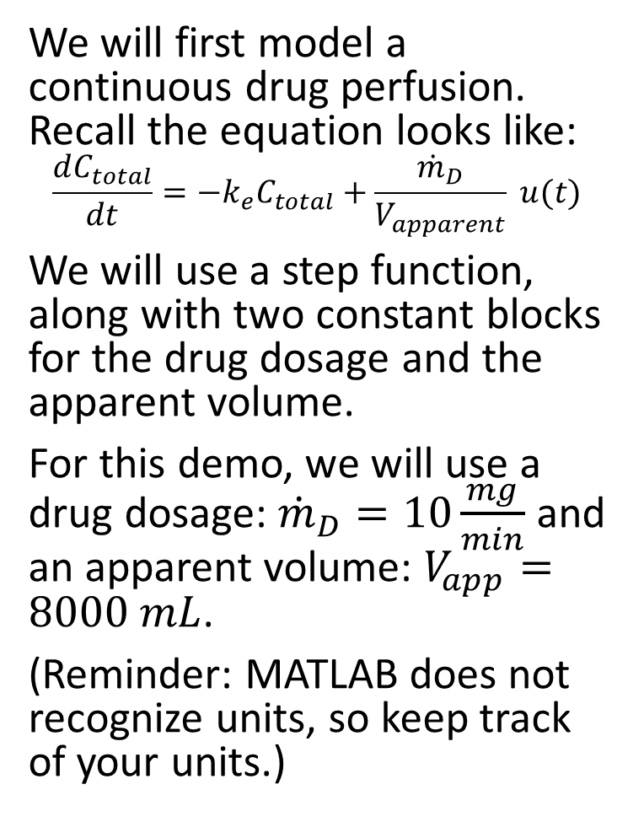
Modeling a Single-Compartment Model
We will first model a continuous drug perfusion. Recall the equation looks like:
$$\frac{dC_{total}}{dt}=−k_{e}C_{total}+\frac{{\dot{m}}_{D}}{V_{apparent}} u(t)$$
We will use a step function, along with two constant blocks for the drug dosage and the apparent volume.
For this demo, we will use a drug dosage: ${\dot{m}}_{D}=10\frac{mg}{min}$ and an apparent volume: $V_{app}=8000 mL$.
(Reminder: MATLAB does not recognize units, so keep track of your units.)
The step and constant blocks can be found under “Sources”.

Slide 7
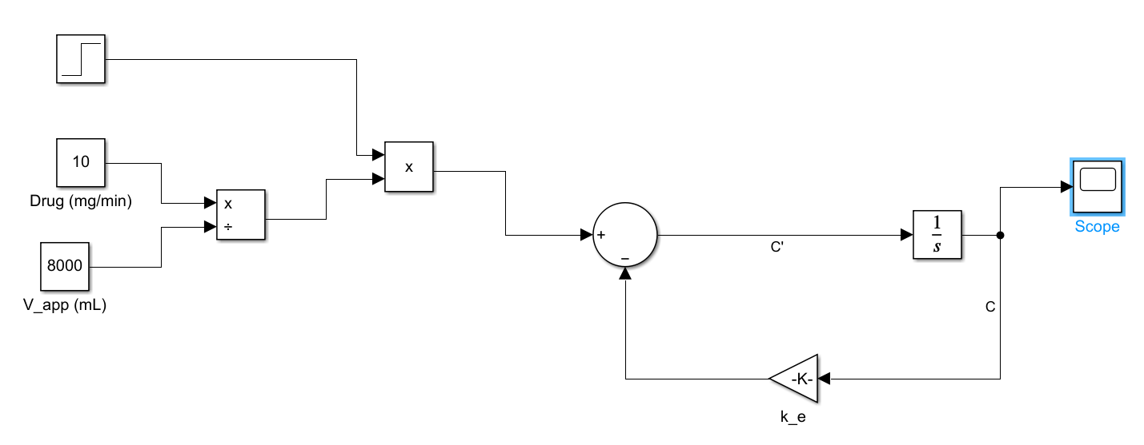
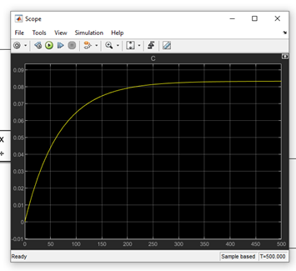
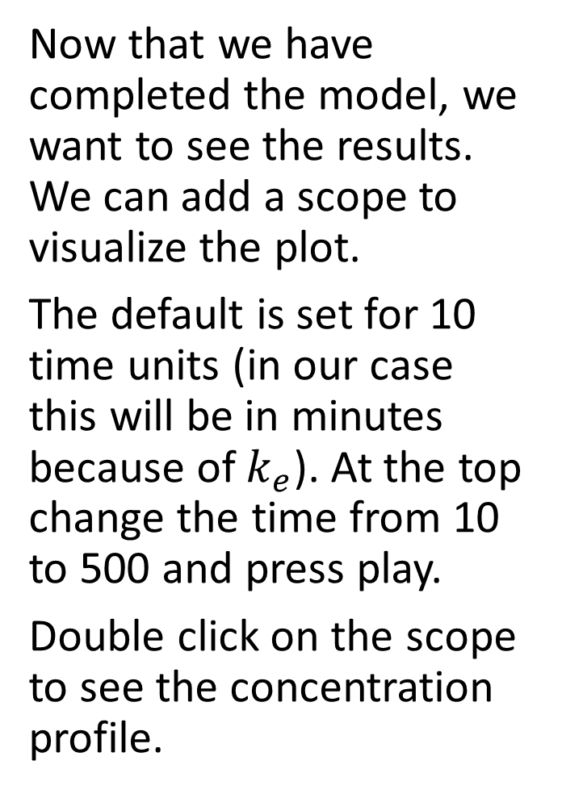
Plotting and Results
The Scope block can be found under “Sinks”.
Now that we have completed the model, we want to see the results. We can add a scope to visualize the plot.
The default is set for 10 time units (in our case this will be in minutes because of $k_{e}$). At the top change the time from 10 to 500 and press play.
Double click on the scope to see the concentration profile.
You can also press play from the scope screen.

Slide 8
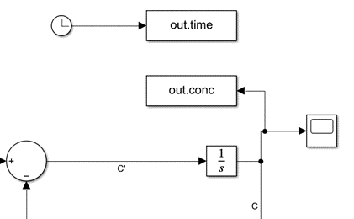
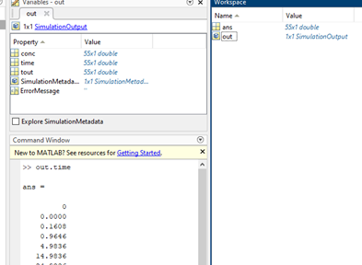
Plotting and Results
“To workspace” blocks can be found under “Sinks”.
Double-click and change the variable name.
Use the clock block (under Sources) to input the time count.
We can also export the data into MATLAB to be used for further processing, plotting (using better tools), or exporting into Excel.
You can use the “To Workspace” blocks to create variables that can be called in MATLAB. Double-click and change the format from “timeseries” to “array”.
Go to the MATLAB screen and click on “out” in the workspace and you should see the variables. You can also call up the variables (e.g., “out.time”).

Slide 9
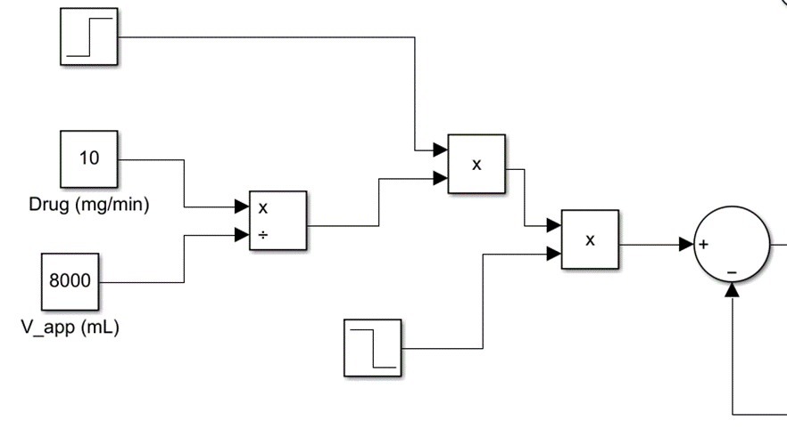
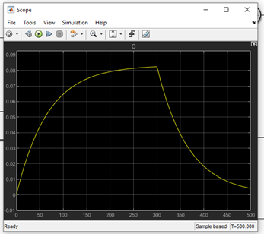
Modeling a Single-Compartment Model
Let’s show what happens if the perfusion is shut off.
We will add another step function, but this one will drop from 1 to 0 at some future time (300 min).
Now the scope should show the “charging” period where the drug concentration builds up during the perfusion, and then decays when the perfusion shuts off.
There are a few ways to do this. One way is to multiply the original step function by a step down function.

Slide 10
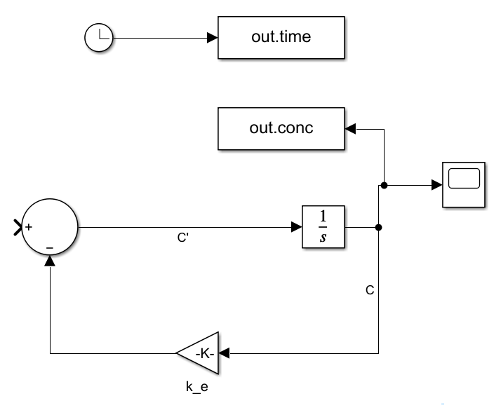
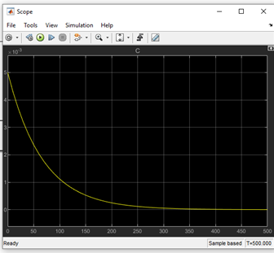
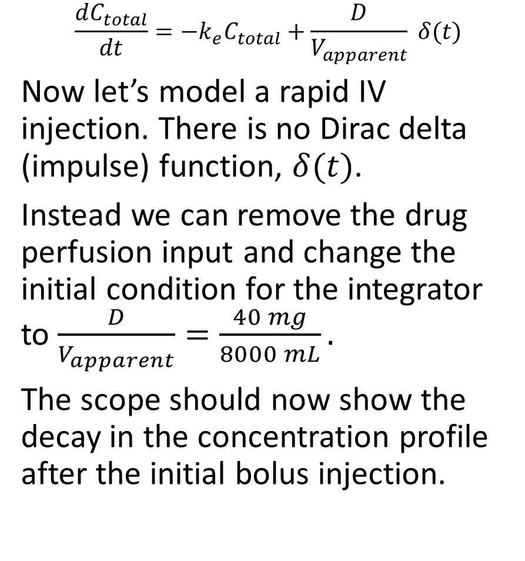
Rapid IV Injection
Double click on the integrator block and change the initial condition.
$$\frac{dC_{total}}{dt}=−k_{e}C_{total}+\frac{D}{V_{apparent}} δ(t)$$
Now let’s model a rapid IV injection. There is no Dirac delta (impulse) function, $δ(t)$.
Instead we can remove the drug perfusion input and change the initial condition for the integrator to $\frac{D}{V_{apparent}}=\frac{40 mg}{8000 mL}.$
The scope should now show the decay in the concentration profile after the initial bolus injection.

Slide 11
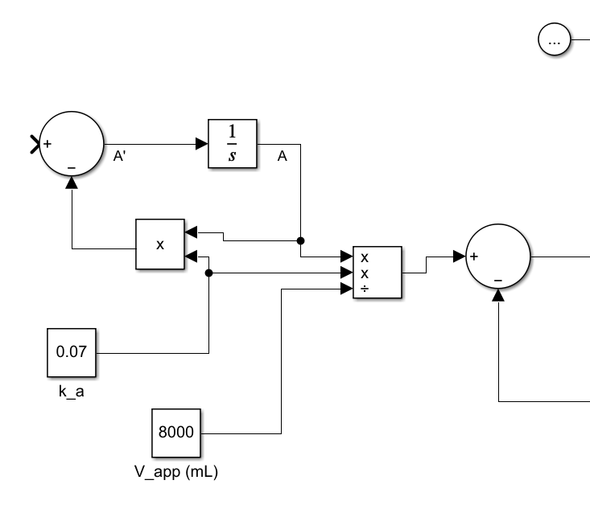
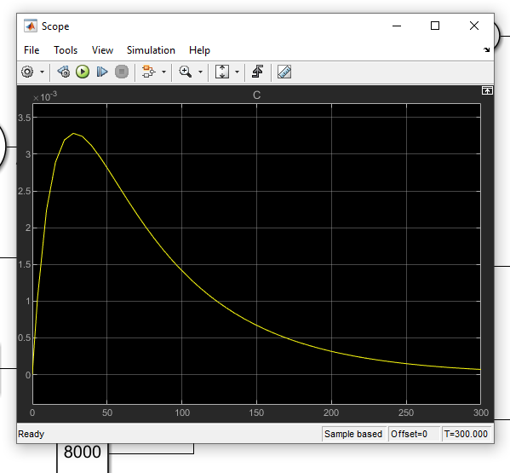
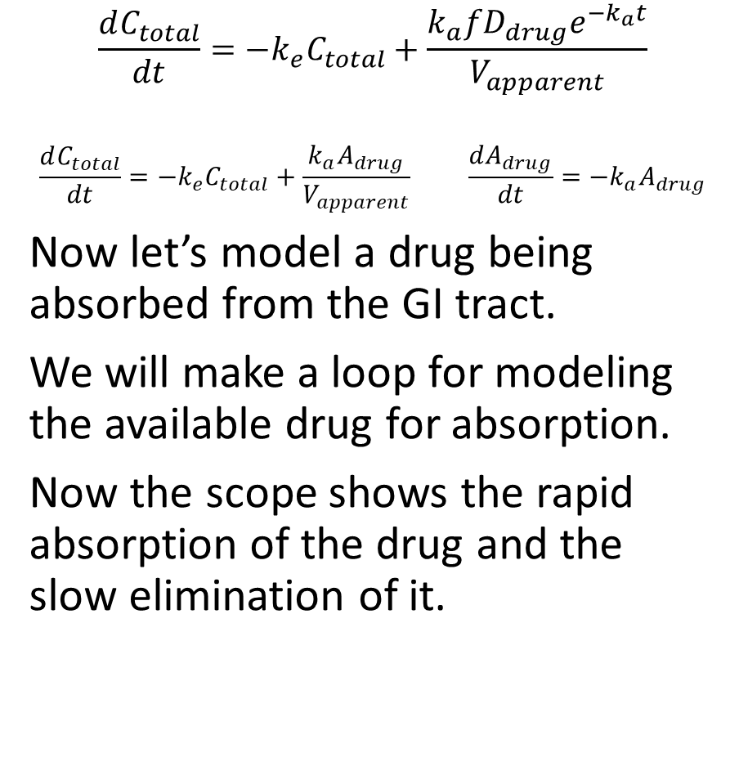
Absorption
Change in the initial drug condition to D (40 mg).
Be sure to change the initial concentration condition back to 0.
$$\frac{dC_{total}}{dt}=−k_{e}C_{total}+\frac{k_{a}fD_{drug}e^{−k_{a}t}}{V_{apparent}}$$
$$\frac{dC_{total}}{dt}=−k_{e}C_{total}+\frac{k_{a}A_{drug}}{V_{apparent}} \frac{dA_{drug}}{dt}=−k_{a}A_{drug}$$
Now let’s model a drug being absorbed from the GI tract.
We will make a loop for modeling the available drug for absorption.
Now the scope shows the rapid absorption of the drug and the slow elimination of it.
Time window was changed to 300

Slide 12
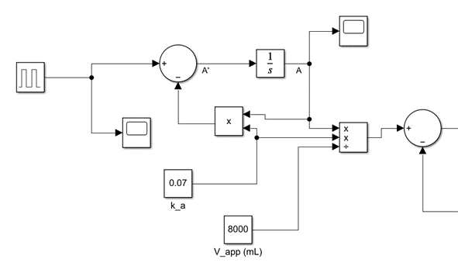
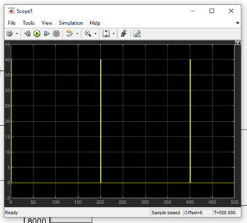

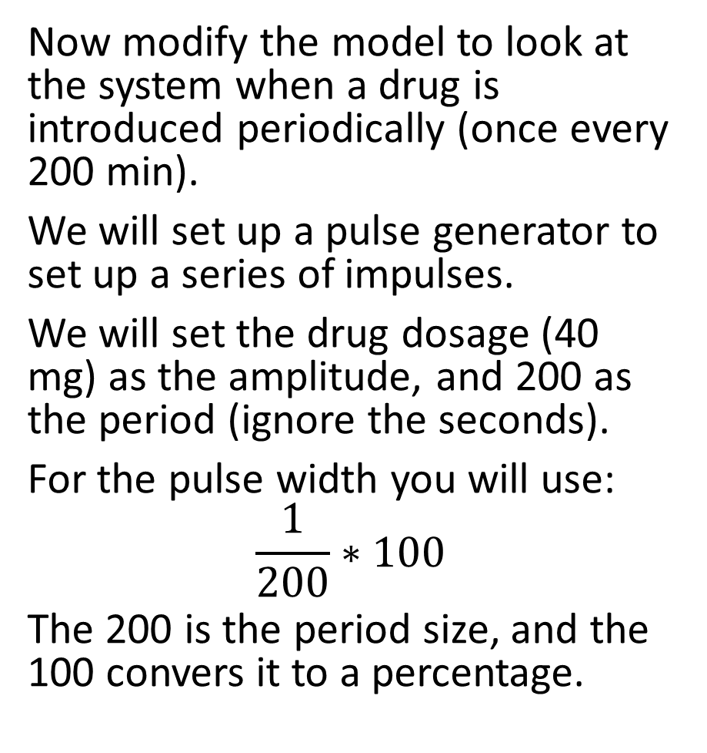
Absorption
Reset initial condition to 0.
Now modify the model to look at the system when a drug is introduced periodically (once every 200 min).
We will set up a pulse generator to set up a series of impulses.
We will set the drug dosage (40 mg) as the amplitude, and 200 as the period (ignore the seconds).
For the pulse width you will use:
$$\frac{1}{200}∗100$$
The 200 is the period size, and the 100 convers it to a percentage.
A scope attached to the pulse generator shows an impulse train.
Drug is administered slightly faster than can initially be removed causing a build up.

Slide 13
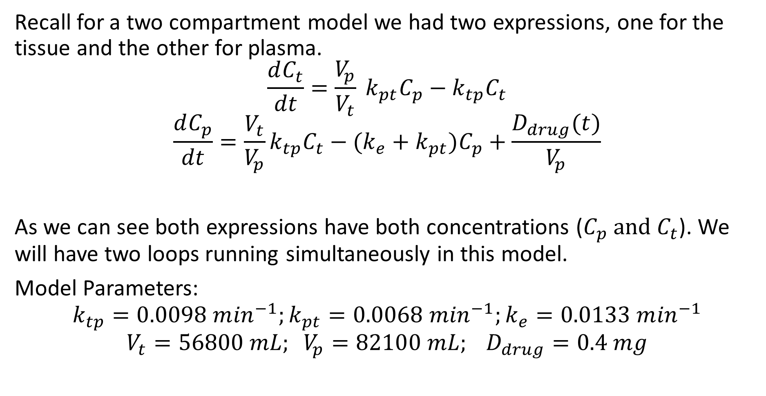
Two Compartment Model
Recall for a two compartment model we had two expressions, one for the tissue and the other for plasma.
$$\frac{dC_{t}}{dt}=\frac{V_{p}}{V_{t}} k_{pt}C_{p}−k_{tp}C_{t}$$
$$\frac{dC_{p}}{dt}=\frac{V_{t}}{V_{p}}k_{tp}C_{t}−(k_{e}+k_{pt})C_{p}+\frac{D_{drug}(t)}{V_{p}}$$
As we can see both expressions have both concentrations ($C_{p} \text{and} C_{t}$). We will have two loops running simultaneously in this model.
Model Parameters:
$$k_{tp}=0.0098 m{in}^{−1};k_{pt}=0.0068 m{in}^{−1};k_{e}=0.0133 m{in}^{−1}$$
$$V_{t}=56800 mL; V_{p}=82100 mL; D_{drug}=0.4 mg$$

Slide 14
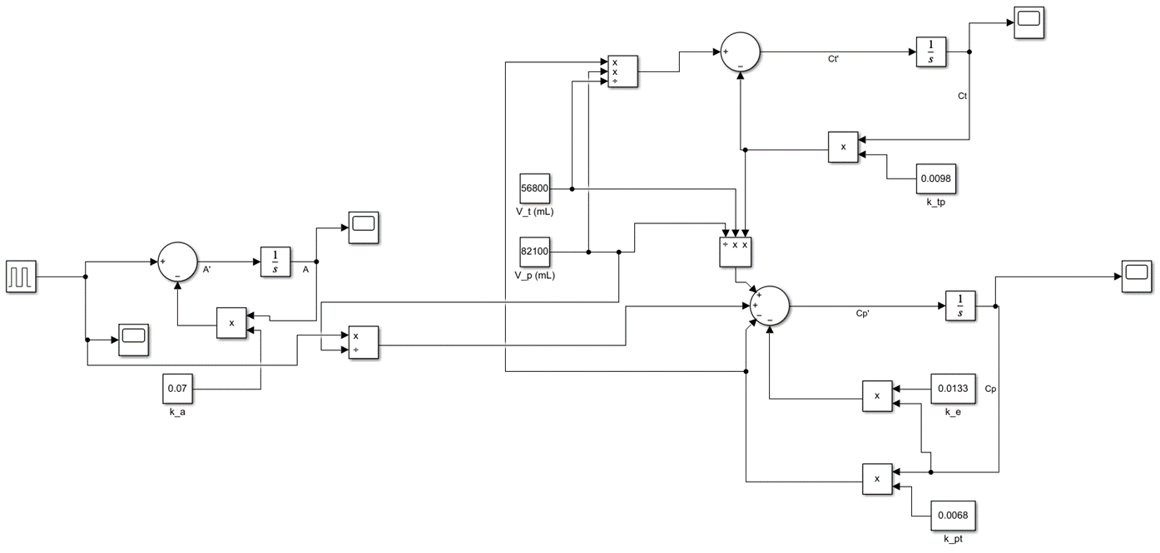
Two Compartment Model
It is important to keep track of your blocks and paths by adding labels. Remember a node connecting two or more paths is marked by a black dot.
Tissue loop
Introduced drug
Plasma loop
Model an IV injection into the plasma using the pulse generator (choose a period larger than time window).
Feed the pulse directly into product/division block (drop the k_{a} input).

Slide 15
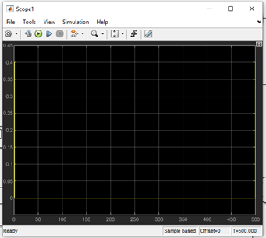
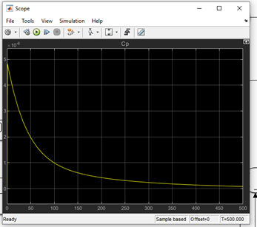
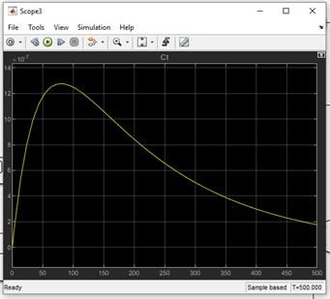
Two Compartment Model
Scope on tissue drug concentration.
Scope on pulse generator shows a single rapid dose of 0.4 mg.
Scope on plasma drug concentration.

Slide 16
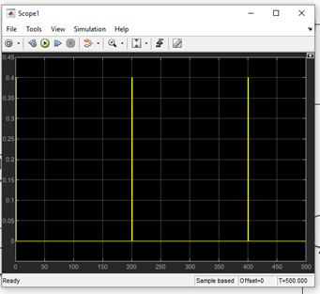
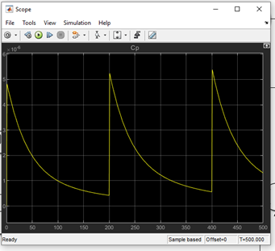
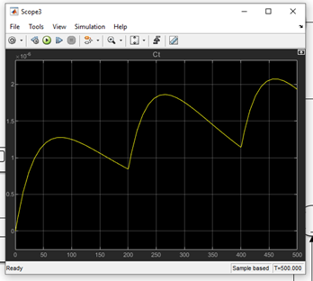
Two Compartment Model – Multiple Injections
Scope on tissue drug concentration showing massive buildup in tissue.
Scope on pulse generator shows rapid dosages of 0.4 mg every 200 minutes.
Scope on plasma drug concentration showing slight build up in plasma.

Slide 17
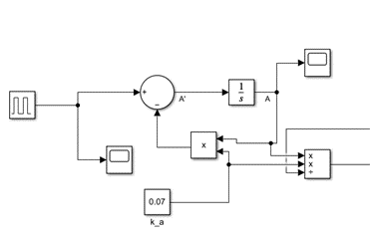
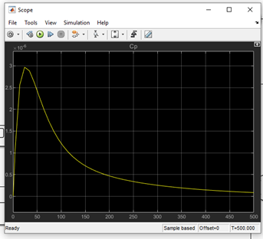
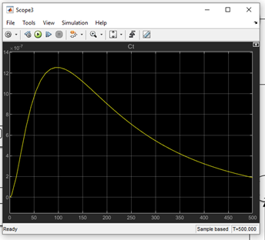
Two Compartment Model – Drug Absorption
Scope on tissue drug concentration.
Make appropriate changes to drug function.
Scope on plasma drug concentration.

Slide 18
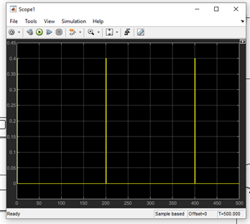
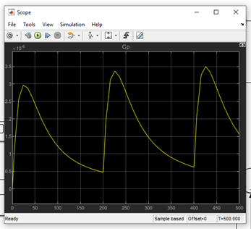
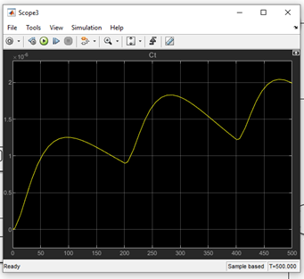
Two Compartment Model – Drug Absorption (multiple)
Scope on tissue drug concentration.
Make appropriate changes to drug function. Scope shows drug (0.4 mg) is taken every 200 minutes.
Scope on plasma drug concentration.

